Slide 1
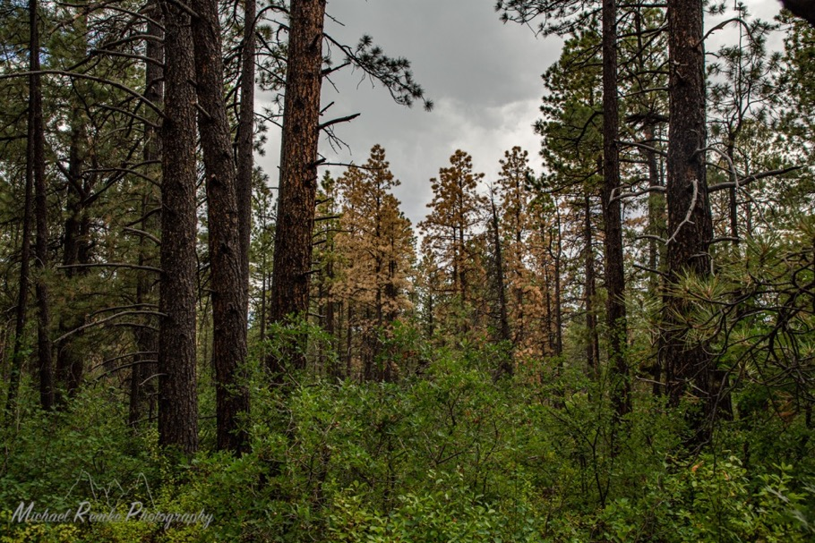



Monitoring Data and Desired Conditions: Lone Pine
Baseline Current Conditions (Pre-treatment)
Dr. Michael Remke

Slide 2

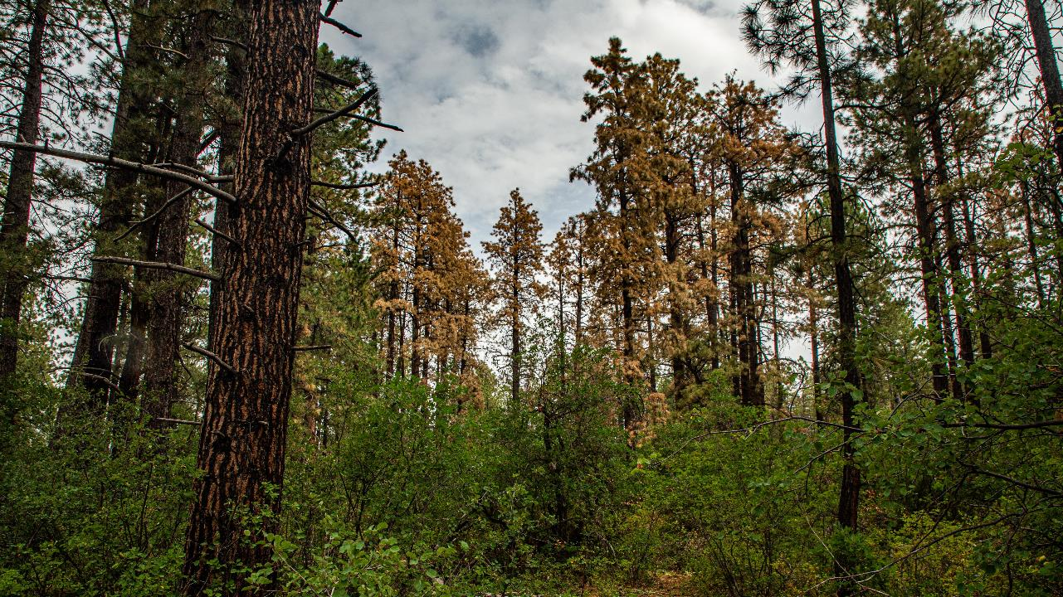





Acknowledgements
Huge thanks to Emily Swindell, Jeremy May, Landon Sawaya, Brenna Gaber, and Hannah Millsap for the support and excellent work in the field this year.
Thank you to Anthony Culpepper, Danny Margoles, and Marin Chambers for support in the development and deployment of monitoring protocols.
A huge thank you to Travis Burch, Davey Casey, and the San Juan National Forest for support in planning and for funding monitoring on the Lone Pine Landscape.
Lastly, thanks to Dr. Mike Battaglia, Dr. Amy Waltz, Dr. Andrew Sanchez-Meador, Travis Wooley, Dana Hayward, Anthony Culpepper, Aaron Kimple, Danny Margoles, Matt Tuten, Tim Leishman, Marin Chambers, and Brett Wolk for support and feedback on this presentation.

Slide 3
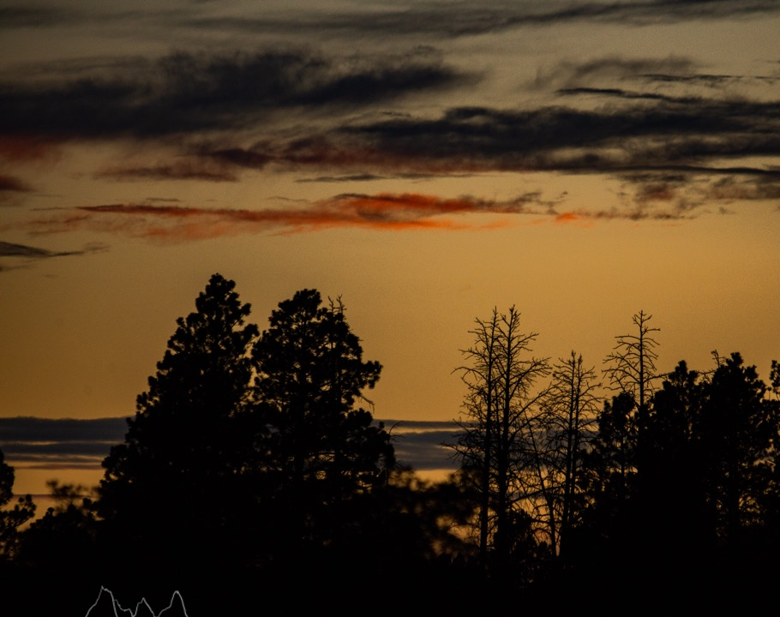
Outline
1. A brief context of the Lone Pine Project Area
2. An overview of Monitoring:
  How the data we collect relates to desired conditions
3. Monitoring Results:
  Monitoring Units
  Ormiston
4. Limitations in inference
Notes:
Lone Pine is a large EA with many elements

Slide 4
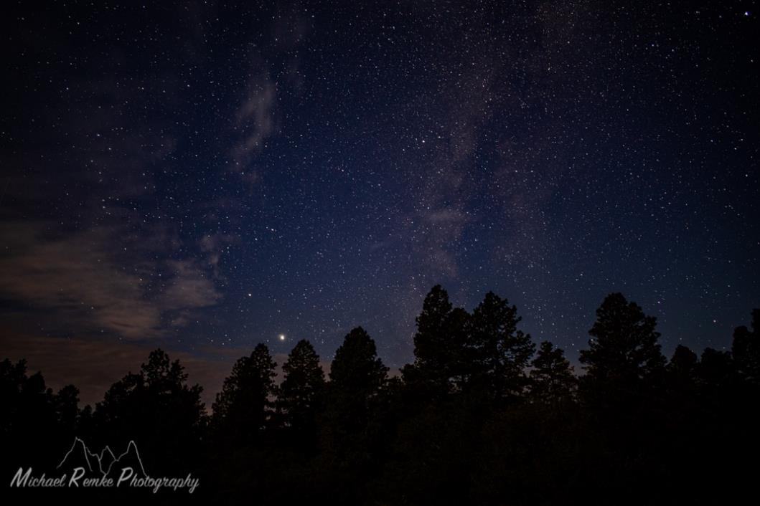
Lone Pine
Lone Pine
Located on the East Rim of the Dolores River
Ponderosa pine dominated Forest
  Pockets of aspen
  Gambel oak dominated understory
    Other shrubs: service berry, snowberry, chokecherry
Productive loam to silt loam soils
  High water holding capacity
    (NRCS Web Soil Survey)
Notes:
Soil depth is also very variable based on a variety of factors including soil rooting depth which varies based on the presence of a hardpan that sometimes approaches the surface.

Slide 5
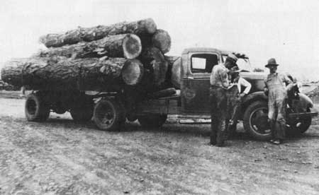
Lone Pine
Legacy of historical logging
Multiple time points
  Including early and mid 1900s
Large tree removal
Notes:
For more details on the legacy of land management on Lone Pine contact David Casey or Bruce Short

Slide 6
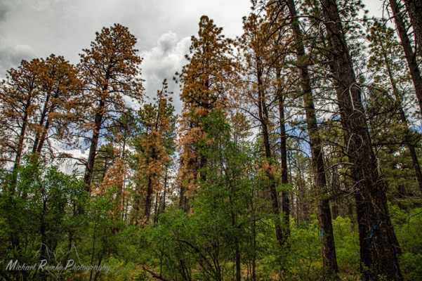
Lone Pine Today
Recent roundheaded beetle/mountain pine beetle mortality
  Unknown:
    Drought related? (Hatmann et al. 2018)
    Stand characteristic related? (Nergron et al. 2009)
CSFS shows over 20,000 acres infested
    Less than 10% of trees killed on 19,400 acres
      Up to 50% killed on <600 acres
      CSFS data went down in acreage from 2018-2019
Notes:
CSFS - https://drive.google.com/drive/folders/1Okim1MOaq1XQOBfRYb9Txq-Xy8FsJuO3?usp=sharing
Hartmann, H., Moura, C. F., Anderegg, W. R. L., Ruehr, N. K., Salmon, Y., Allen, C. D., Arndt, S. K., Breshears, D. D., Davi, H., Galbraith, D., Ruthrof, K. X., Wunder, J., Adams, H. D., Bloemen, J., Cailleret, M., Cobb, R., Gessler, A., Grams, T. E. E., Jansen, S., … O’Brien, M. (2018). Research frontiers for improving our understanding of drought-induced tree and forest mortality. New Phytologist, 218(1), 15–28. https://doi.org/10.1111/nph.15048
Negrón, J. F., Wilson, J. L., & Anhold, J. A. (2009). Stand Conditions Associated with Roundheaded Pine Beetle (Coleoptera: Scolytidae) Infestations in Arizona and Utah. Environmental Entomology, 29(1), 20–27. https://doi.org/10.1603/0046-225x-29.1.20

Slide 7
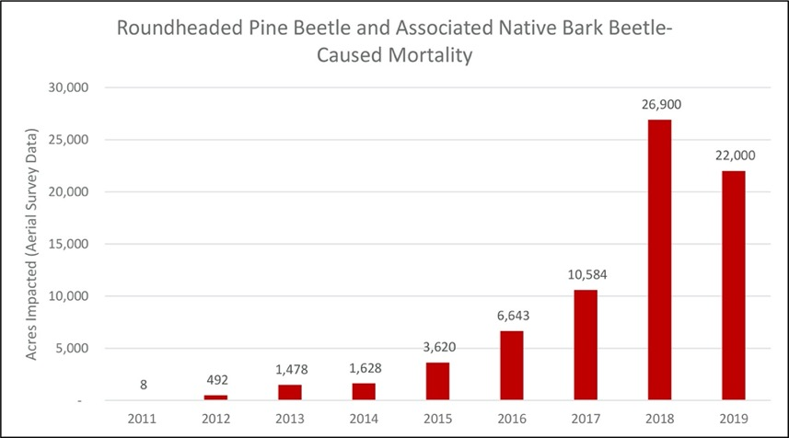
Roundheaded Beetle
Primarily in Lone Pine Landscape in 2019
Some small polygons in Dry Canyon (N of McPhee) and Elston Mountain
https://csurams.maps.arcgis.com/apps/MapJournal/index.html?appid=7d49022bff5a49a099c63320d421ea36
Notes:
It is important to note that these numbers represent new incidents of observed mortality and polygons may encompass large areas with low intensity. Additionally, polygons from one year may overlap polygons from the previous year thus thee numbers do not represent acreage of mortality.

Slide 8
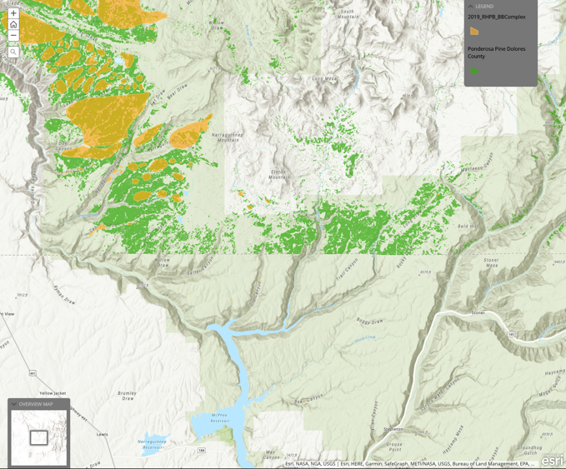
Roundheaded Beetle
Primarily in Lone Pine Landscape in 2019
Some small polygons in Dry Canyon (N of McPhee) and Elston Mountain
https://csurams.maps.arcgis.com/apps/MapJournal/index.html?appid=7d49022bff5a49a099c63320d421ea36

Slide 9
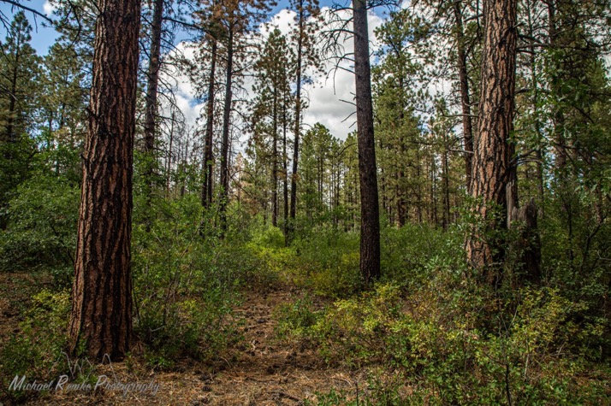
Lone Pine Environmental Assessment
Objectives
  Increase forest resilience
  Increase tree age class diversity
  Promote recovery of forest
  Reduce risk of high severity wildfires
  Provide wood products
Target Basal Area
  50-70 ft²/acre
Notes:
For more information on detailed objectives please see the Lone Pine EA and the Lone Pine DN.

Slide 10
Lone Pine Environmental Assessment
Objectives
  Increase forest resilience
  Increase tree age class diversity
  Promote recovery of forest
  Reduce risk of high severity wildfires
  Provide wood products
Target Basal Area
  50-70 ft²/acre
    Thinning across all size classes
Notes:
For more information on detailed objectives please see the Lone Pine EA and the Lone Pine DN.

Slide 11
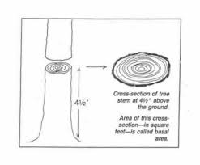
What is Basal Area
Area of tree stems –
  Useful for thinking about the amount of wood
Notes:
The Basal Area is the cross sectional area of tree stems in square feet. Basal area is an important metric in calculating the amount of wood on the forest.

Slide 12
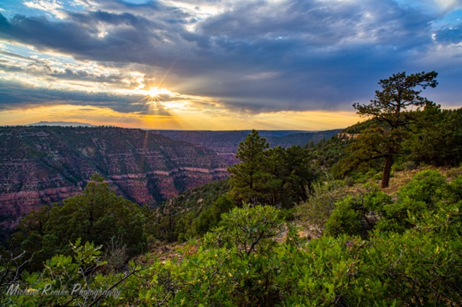
Lone Pine Treatments
Single Tree Selection (STS)
  Uneven-aged regeneration methods where individual trees of all size classes are removed
    Target of 50 BA / acre, no trees >26” removed
Commercial Thinning (CT)
  20” Large Tree Retention (LTR)- no trees over 20” removed
  Goal is to promote resiliency to disturbances. Individuals of all size classes are removed.
    Target of 60 BA / acre
Plantation Thinning
  Planted and heavily stocked areas
    Same as commercial thin, but target BA is 70
Notes:
Lone Pine also has a Salvage Treatment where tree mortality is >= 65% of standing trees. In this instance all defect and killed trees would be removed. Otherwise, these treatments are detailed in the Lone Pine EA

Slide 13
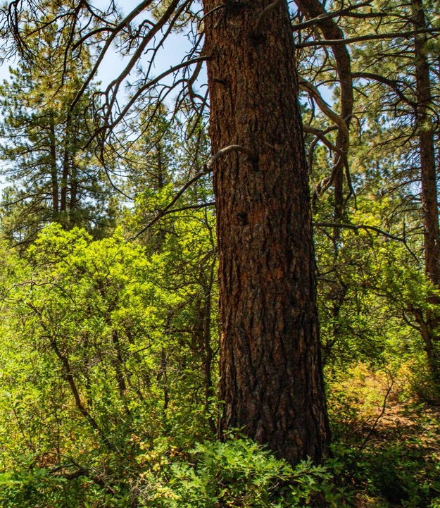
Large Tree Retention
No trees ≥ 20” will be removed
  Does not distinguish tree age
  Could retain young fast growing and old slow growing trees
The Brumley Units and part of Fader applied the LTR concept to the STS treatments
  No monitoring units here.
Notes:
The Large Tree Retention units are applied to all the commercial thin and plantation treatments as well as some of the Single Tree Selection Units in Fader and Brumley

Slide 14
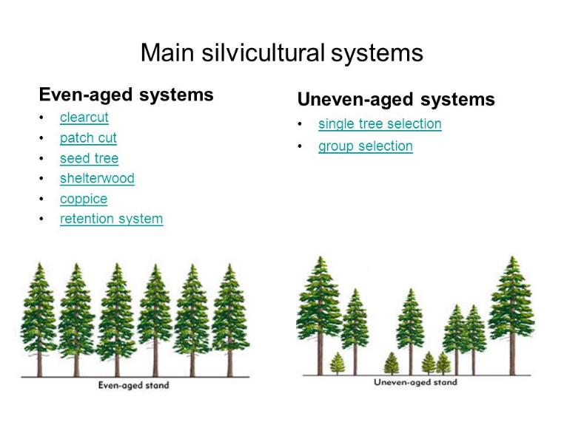
What is uneven-aged silviculture?
More than two ages
  Multiple development stages
Notes:
Waveland Press - Ecological Silviculture - Foundations and Applications by Brian J. Palik, Anthony W. D'Amato, Jerry F. Franklin, K. Norman Johnson
https://www.waveland.com/browse.php?t=747
Accessed: 2020-11-10

Slide 15
What is uneven-aged silviculture?
More than two ages
1. Old trees
Notes:
Waveland Press - Ecological Silviculture - Foundations and Applications by Brian J. Palik, Anthony W. D'Amato, Jerry F. Franklin, K. Norman Johnson
https://www.waveland.com/browse.php?t=747
Accessed: 2020-11-10

Slide 16
What is uneven-aged silviculture?
More than two ages
1. Old trees
2. Middle aged trees
Multiple sizes?
Fast vs slow growers
Notes:
Waveland Press - Ecological Silviculture - Foundations and Applications by Brian J. Palik, Anthony W. D'Amato, Jerry F. Franklin, K. Norman Johnson
https://www.waveland.com/browse.php?t=747
Accessed: 2020-11-10

Slide 17
What is uneven-aged silviculture?
More than two ages
1. Old trees
2. Middle aged trees
Multiple sizes?
Fast vs slow growers
3. Young trees
Notes:
Waveland Press - Ecological Silviculture - Foundations and Applications by Brian J. Palik, Anthony W. D'Amato, Jerry F. Franklin, K. Norman Johnson
https://www.waveland.com/browse.php?t=747
Accessed: 2020-11-10

Slide 18
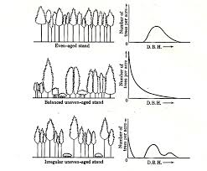
What does it look like?
Diameter distribution
  Multiple age classes
    Often more small trees than large ones
      Results in a ‘Reverse J’
        Balanced
      Can also be a ‘bi-modal’ or ‘tri-modal ‘distribution
        Irregular
Trees/Acre
Even-Aged
DBH
Trees/Acre
Balanced Uneven-Aged
DBH
Trees/Acre
Irregular Uneven-Aged
DBH
Nyland – Silviculture Concepts and Application
Notes:
Waveland Press - Ecological Silviculture - Foundations and Applications by Brian J. Palik, Anthony W. D'Amato, Jerry F. Franklin, K. Norman Johnson
https://www.waveland.com/browse.php?t=747
Accessed: 2020-11-10

Slide 19
What do uneven-aged stands look like?
Diameter distribution
  Multiple age classes
    Often more small trees than large ones
      Results in a ‘Reverse J’
        Balanced
      Can also be a ‘bi-modal’ or ‘tri-modal ‘distribution
        Irregular
Trees/Acre
Even-Aged
DBH
Trees/Acre
Balanced Uneven-Aged
DBH
Frequent disturbance forests –
Could have multiple development stages across space
  Groups of even-aged of young or old trees
  (Palik et al. 2020)
Trees/Acre
Irregular Uneven-Aged
DBH
Nyland – Silviculture Concepts and Application
Notes:
Waveland Press - Ecological Silviculture - Foundations and Applications by Brian J. Palik, Anthony W. D'Amato, Jerry F. Franklin, K. Norman Johnson
https://www.waveland.com/browse.php?t=747
Accessed: 2020-11-10

Slide 20
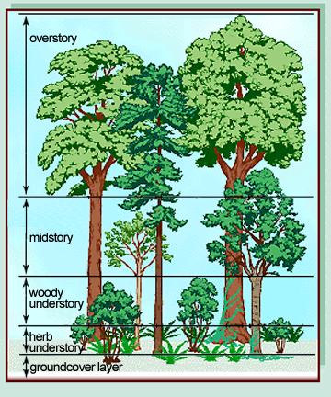
What do uneven-aged stands look like?
Uneven aged stands in ponderosa pine have patches of canopy openings and canopy closure.
Trees providing canopy cover can be overstory co-dominate trees, midstory trees, or young understory trees.
(O’Hara 2005, Wightman 2008)
Notes:
O’Hara, K. L. (2005). Multiaged silviculture of ponderosa pine. Symposium on Ponderosa Pine: Issues, Trends, and Management, 2004 October 18-21, Klamath Falls, OR. Gen. Tech. Rep PSW-GTR-198, 3114, 59–70.
Wightman, Catherine S.; Rosenstock, Steven S. 2008. Restoration of southwestern ponderosa pine forests: Implications and opportunities for wildlife. In: Gottfried, Gerald J.; Shaw, John D.; Ford, Paulette L., compilers. 2008. Ecology, management, and restoration of pinon-juniper and ponderosa pine ecosystems: combined proceedings of the 2005 St. George, Utah and 2006 Albuquerque, New Mexico workshops. Proceedings RMRS-P-51. Fort Collins, CO: U.S. Department of Agriculture, Forest Service, Rocky Mountain Research Station. p. 194.

Slide 21
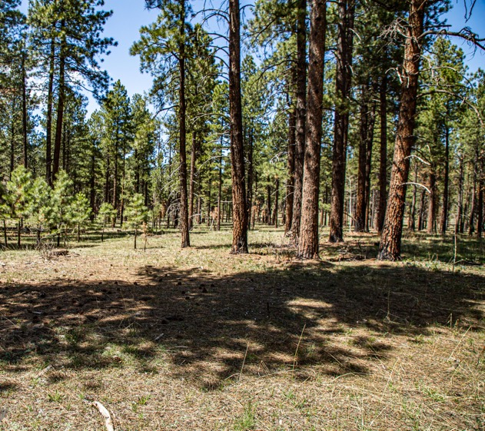
Why uneven-aged?
Historically, un-even aged stands existed on the SJNF
  (Brown & Wu et al. 2005, Romme et al. 2009, Baker et al. 2020)
Numerous younger trees and numerous older trees
Diameter (cm)
Notes:
Brown, P. M., Wu, R., Brown, P. M., Wu, R., & Brown, P. M. (2005). Climate and disturbance forcing of episodic tree recruitment in a southwestern ponderosa pine landscape. Ecology, 86(11), 3030–3038. https://doi.org/10.1890/05-0034
Romme, W. H., Floyd, M. L., Hanna, D., Crist, M., Green, D., Lindsey, J. P., Mcgarigal, K., & Redders, J. S. (2009). Historical Range of Variability and Current Landscape Condition Analysis : South Central Highlands Section , Southwestern Colorado & Northwestern New Mexico Table of Contents. Physical Geography, May.
Baker, W. L. (2020). Variable Forest Structure and Fire Reconstructed Across Historical Ponderosa Pine and Mixed Conifer Landscapes of the San Juan Mountains, Colorado William. 1–35.

Slide 22
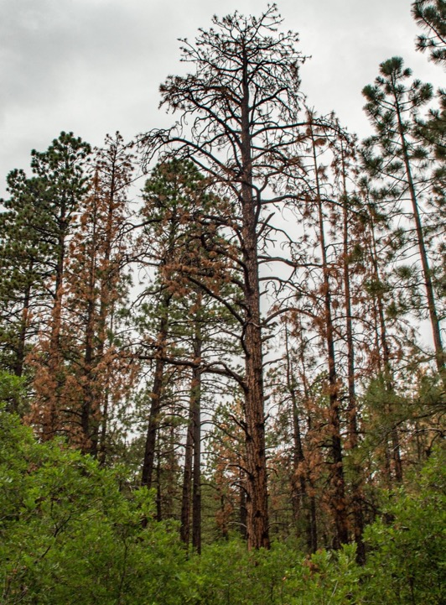
Why uneven-aged?
Uneven-aged stands help create more resilience to….
  Beetles – Age class diversity and different growth rates promotes resilience to beetle (Negrón et al. 2008, Fisher et al. 2010)
  Drought – Age class diversity can result in physiological diversity to promote resilience (Kolb et al. 2016)
Notes:
Fischer, M. J., Waring, K. M., Hofstetter, R. W., & Kolb, T. E. (2010). Ponderosa pine characteristics associated with attack by the roundheaded pine beetle. Forest Science, 56(5), 473–483.
Negrón, J. F., Bentz, B. J., Hansen, M. E., Fettig, C. J., Gillette, N., Hayes, J. L., Kelsey, R. G., Progar, R. A., Lundquist, J. E., Lynch, A. M., & Seybold, S. J. (2008). US forest service bark beetle research in the western United States: Looking toward the future. Journal of Forestry, 106(6), 325–331. https://doi.org/10.1093/jof/106.6.325
Kolb, T. E., Grady, K. C., McEttrick, M. P., & Herrero, A. (2016). Local-Scale Drought Adaptation of Ponderosa Pine Seedlings at Habitat Ecotones. Forest Science, 62(6), 641–651. https://doi.org/10.5849/forsci.16-049

Slide 23
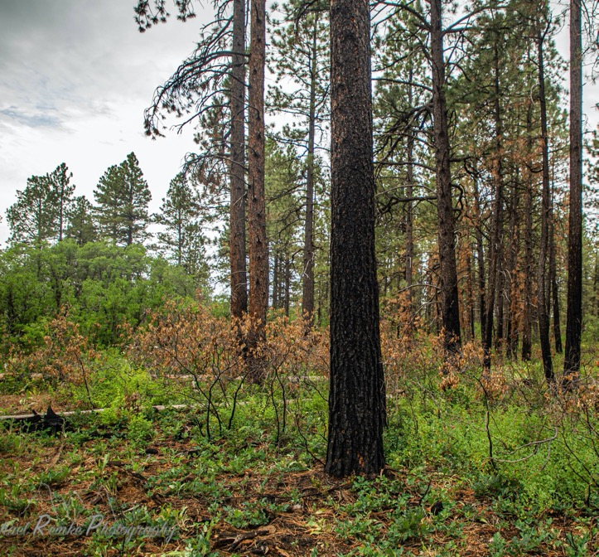
Variability
Maintaining variation in landscape promotes resilience too.
  Spatial and vertical
Discontinuity of fuels to influence fire behavior
Open areas, areas with young trees, etc.
Notes:
Palik et al. 2020

Slide 24
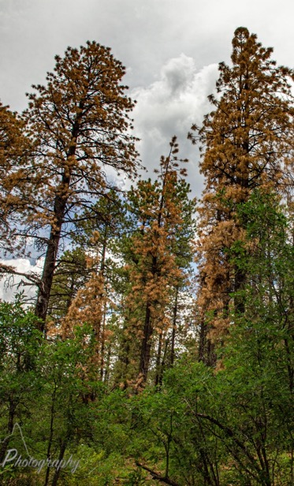
Beetle Outbreaks
Roundheaded beetle, Mountain pine beetle and Western bark beetle as well as Ips beetle are all native, co-occurring beetles (RMRS-GTR-241, Negrón et al. 2009, Jeske 2010).
Roundheaded outbreaks are associated with high stocking densities and drought stress or reduced tree growth (Negrón et al. 2011, Fischer et al. 2010)
  Up to 66% tree mortality observed in AZ, NM, and UT.
Notes:
Negrón, J. F., McMillin, J. D., Anhold, J. A., & Coulson, D. (2009). Bark beetle-caused mortality in a drought-affected ponderosa pine landscape in Arizona, USA. Forest Ecology and Management, 257(4), 1353–1362. https://doi.org/10.1016/j.foreco.2008.12.002
Fischer, M. J., Waring, K. M., Hofstetter, R. W., & Kolb, T. E. (2010). Ponderosa pine characteristics associated with attack by the roundheaded pine beetle. Forest Science, 56(5), 473–483.
Negron, J. (2011). Estimating probabilities of infestation and extent of damage by the roundheaded pine beetle in ponderosa pine in the Sacramento Mountains, New Mexico. Canadian Journal of Forest Research, 27(12), 1936–1945. https://doi.org/10.1139/x97-158
Jeske, B. (n.d.). Roundheaded Pine Beetle Epidemic : Coconino National Forest Flagstaff , Arizona. 1–26.

Slide 25
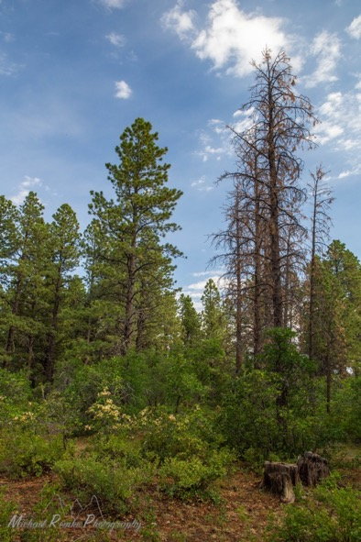
Management Intervention for Beetles
Management intervention during outbreaks can reduce tree mortality during an outbreak (Fettig et al. 2014, Negrón et al 2020).
Removal of all trees with beetle evidence may remove potential survivors that are resistant to beetle attack
  Some evidence from a lodgepole pine system (Six et al. 2018).
  Knowledge gap in ponderosa – though Hofstetter and Kolb have ongoing grad student projects…
Notes:
Fettig, C. J., Gibson, K. E., Munson, A. S., & Negrón, J. F. (2014). Cultural practices for prevention and mitigation of mountain pine beetle infestations. Forest Science, 60(3), 450–463. https://doi.org/10.5849/forsci.13-032
Six, D. L., Vergobbi, C., & Cutter, M. (2018). Are survivors different? Genetic-based selection of trees by mountain pine beetle during a climate change-driven outbreak in a high-elevation pine forest. Frontiers in Plant Science, 9(July), 1–11. https://doi.org/10.3389/fpls.2018.00993
Negrón, J. F. (2020). Within-stand distribution of tree mortality caused by mountain pine beetle, Dendroctonus ponderosae hopkins. Insects, 11(2). https://doi.org/10.3390/insects11020112

Slide 26
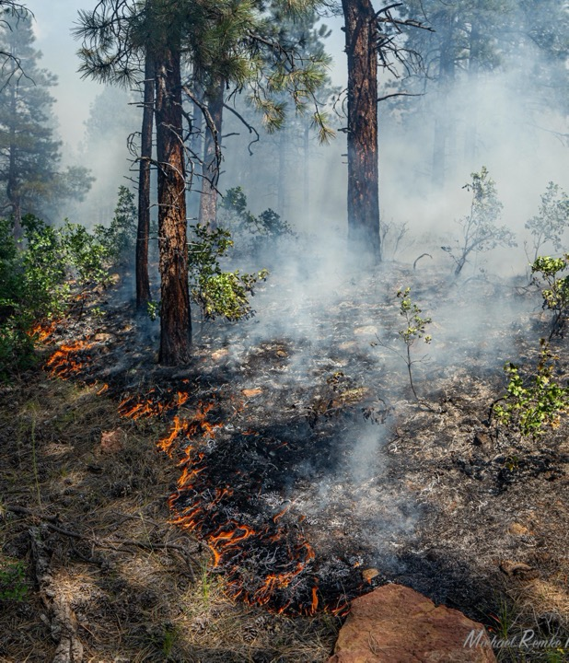
Fire
Ponderosa pine in the San Juan mountains historically experienced frequent surface fire (Fúle et al. 2009),
Occasionally the accumulation of fuels and drier conditions favored less frequent mixed severity fire (Baker et al. 2020)
Notes:
Fulé, P. Z., Korb, J. E., & Wu, R. (2009). Changes in forest structure of a mixed conifer forest, southwestern Colorado, USA. Forest Ecology and Management, 258(7), 1200–1210. https://doi.org/10.1016/j.foreco.2009.06.015
Baker, W. L (2020). Variable forest structure and fire reconstruction across historical ponderosa pine and mixed conifer landscapes of the San Juan Mountains, Colorado. Land, 9(3), 1–35. https://doi/10.3390/land90100003

Slide 27
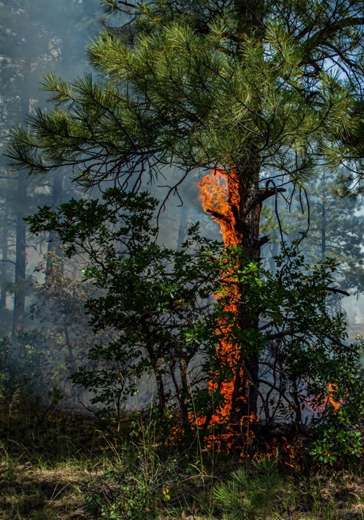
Fire
Factors including the connectivity of fuel influence fire behavior.
  Tree density – small trees can serve as ladder fuels and create horizontal fuel connectivity
  Crown base height – trees with lower branches are more likely to torch or carry fire to the canopy.
  Shrub cover – taller shrubs or tree like oak under the right conditions can also serve as a fuel connector to the canopy and increase fire behavior

Slide 28
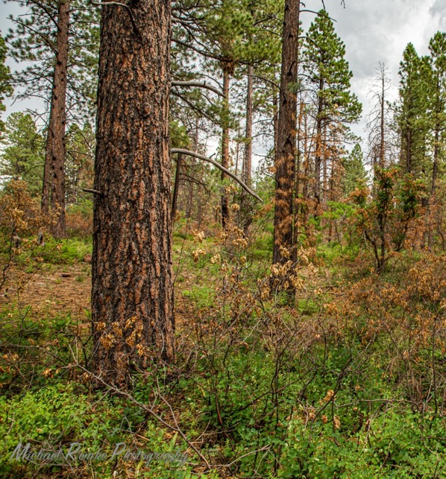
Drought
Drought stress over recent decades makes trees more susceptible to insect related mortality
  Slows growth (Fischer et al. 2010, Kolb et al. 2016)
Drought stress is exacerbated in higher density stands (Kolb et al. 2016)
  Thinning can alleviate drought stress (Bottero et al. 2017).
Dry conditions may also inhibit ponderosa pine regeneration (Rodman et al 2020a,b).
Notes:
Bottero, A., D’Amato, A. W., Palik, B. J., Bradford, J. B., Fraver, S., Battaglia, M. A., & Asherin, L. A. (2017). Density-dependent vulnerability of forest ecosystems to drought. Journal of Applied Ecology, 54(6), 1605–1614. https://doi.org/10.1111/1365-2664.12847
Kolb, T. E., Grady, K. C., McEttrick, M. P., & Herrero, A. (2016). Local-Scale Drought Adaptation of Ponderosa Pine Seedlings at Habitat Ecotones. Forest Science, 62(6), 641–651. https://doi.org/10.5849/forsci.16-049
Rodman, K. C., Veblen, T. T., Battaglia, M. A., Chambers, M. E., Fornwalt, P. J., Holden, Z. A., Kolb, T. E., Ouzts, J. R., & Rother, M. T. (2020). A changing climate is snuffing out post-fire recovery in montane forests. Global Ecology and Biogeography, August. https://doi.org/10.1111/geb.13174
Rodman, K. C., Veblen, T. T., Chapman, T. B., Rother, M. T., Wion, A. P., & Redmond, M. D. (2020). Limitations to recovery following wildfire in dry forests of southern Colorado and northern New Mexico, USA. Ecological Applications, 30(1), 1–20. https://doi.org/10.1002/eap.2001

Slide 29
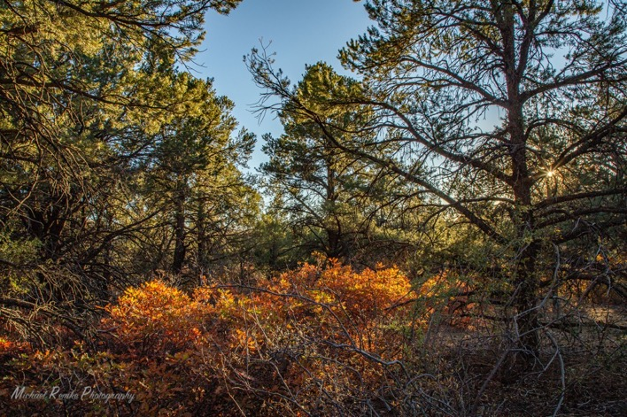

DWRF Desired Conditions Linked to Monitoring
1. Tree species composition that promotes ecological resilience
  Retain or restore historical species/ecotypes and genetic diversity, as well as species associated with climate related trends/movement
    Ponderosa pine, pinon pine, rocky mountain juniper
2. Retain and enhance rare or uncommon species composition when feasible (e.g. Aspen or aspen clones)

Slide 30
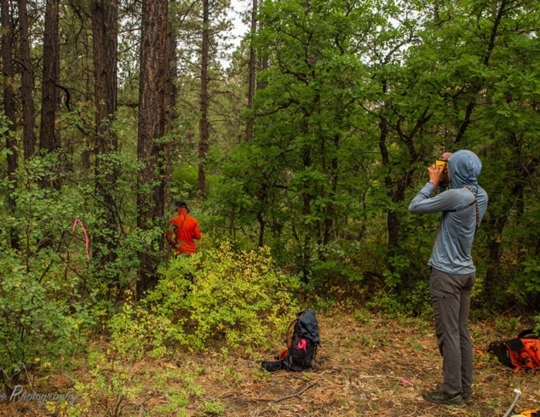

Methods
1/10th Acre (37.2 foot radius) Fixed Radius sub-plots
  All trees within 1/10th acre were counted, measured
    DBH, Height, Crown Base Height
    Beetle presence (pitch tubes, galleries)

Slide 31
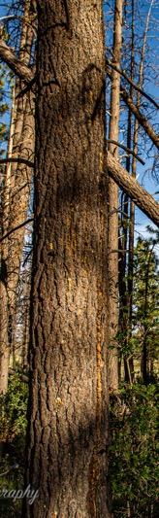
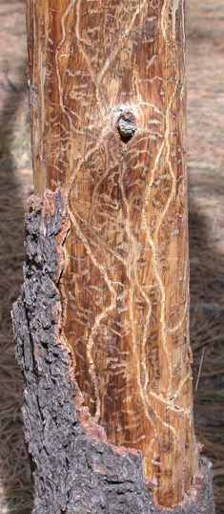
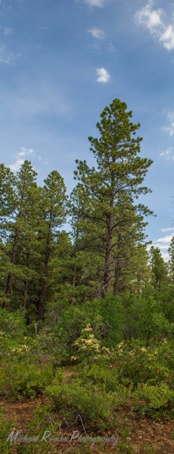
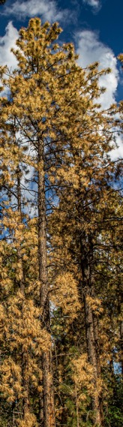
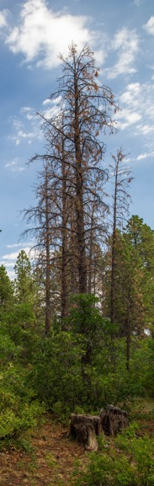
Beetle Evidence
Pitch tubes
~ Sign of frass
~ Sap from entry/exit tubes
Galleries
~Indicates more developed beetle attack
Green
Brown
~ Recent mortality
Dead
~ Older mortality
Notes:
Beetle evidence was recorded for all trees

Slide 32
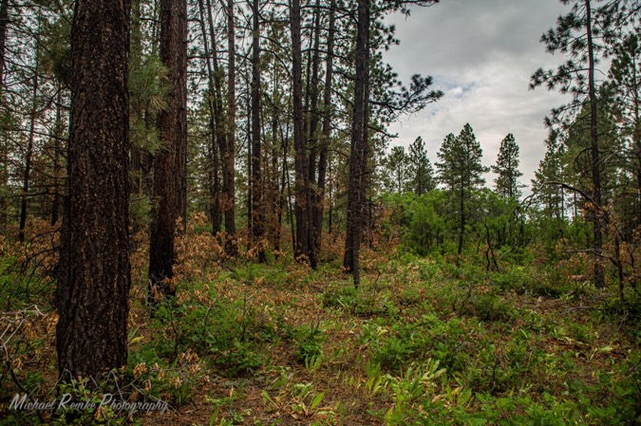

Desired Conditions: Diverse age classes
Stand scale – complex mosaic of tree sizes that promote ecological resilience
  Restore historical heterogeneity in tree size classes and age classes
    Increased seedlings and saplings

Slide 33
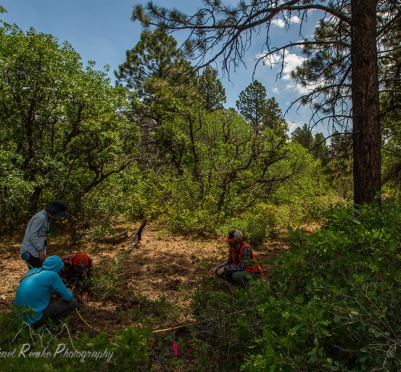

Methods
1/10th Acre Fixed Radius sub-plots
  All trees within 1/10th acre were counted, measured
    DBH, Height, Crown Base Height
1/100th (11.78 feet)
  Acre Regeneration sub-plots
    Three regeneration plots per plot were used to count seedlings and saplings
    Along a 30 m transect (0m,15m,30m) to capture variation within plot
    Height classes, diameters of saplings

Slide 34
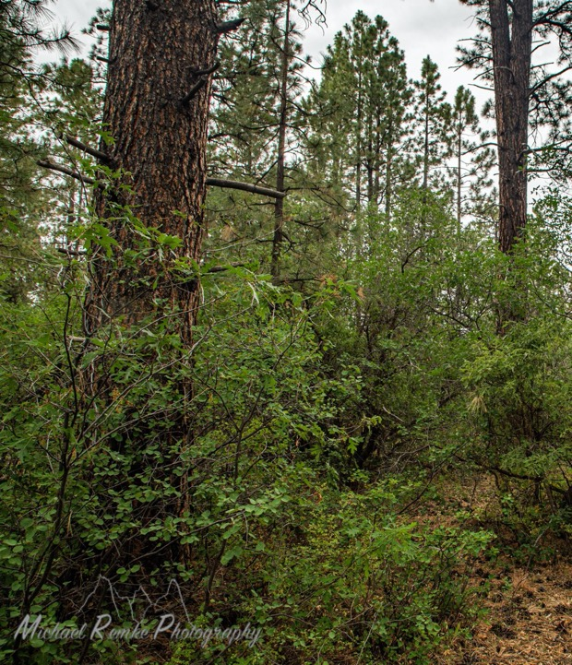
Understory
Mosaic of forest understory shrub composition, density, and size that promotes ecological resilience
  Maintain or restore historically variable Gambel Oak and other shrub densities that also enable variable ponderosa pine regeneration, forb and grass abundance, and meets wildlife needs

Slide 35

Methods
1/100th Acre Regeneration sub-plots
  One regeneration plot per plot was used to count oak and other shrub stems
Shrub cover
  Line intercept method along a 30m transect at each plot
Canopy cover
  Canopy cover by species and canopy class was also measured along this 30 m transect

Slide 36
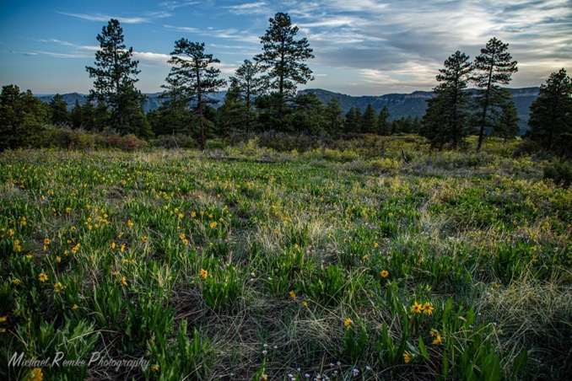

Grasses and Forbs
Mosaic of forest understory grass and forb composition, density, and cover that promotes ecological resilience
  Promote and restore historically variable native grass and forb abundance and composition.

Slide 37
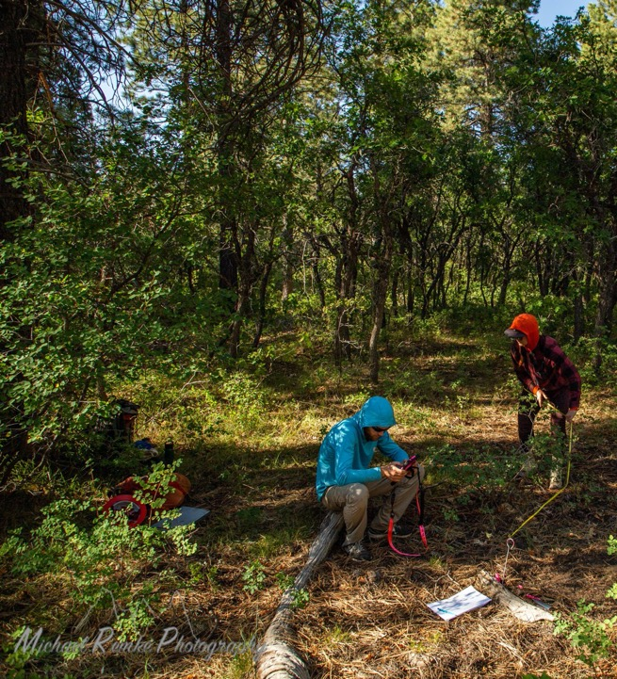

Grasses and Forbs
Four 1m² subplots along the 30 m transect to measure forb, grass, and seedling cover
Also – measured fuel loads in these frames and ground cover (litter, bare soil, etc)
Invasive Species were also measured, however, we only found plots in treatment areas associated with the Lake Canyon EA.

Slide 39
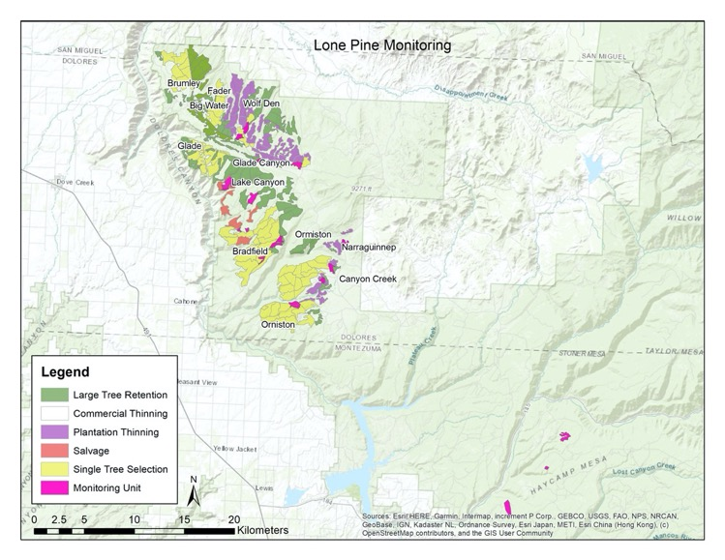
Lone Pine Monitoring in the Decision Notice
14 Monitoring Units
  Several within Lone Pine
    Some represent controls
      Glade Canyon
      Lake Canyon Salvage
      BEST has two controls
    Bradfield Test Mark
    Ferris PPP treatment
    Wolf Den and Narraguinnep plantations
    Haycamp – Less beetle activity (3 units)
    Lake Canyon EA – 5 pines

Slide 40
Monitoring Units - All Trees – Density by Size
BESTt
Bradfield Test Mark
Canyon Creek
Fader
Glade Canyon
Control
Haycamp
- PPP
Lake Canyon
Snaggle Tooth
Lake Canyon Salvage
Lake Canyon EA
5 Pines
Narraguinnep
Plantation
Ferris East
Wolf Den
Plantation
These monitoring units are highly variable. We could walk trough each of them individually, but that would be a lot of graphs with a lot of unique narratives – I guess I could present on Lone Pine for the next several months.

Slide 41
Monitoring Units – Ponderosa , BA x Size
BESTt
Bradfield Test Mark
Canyon Creek
Fader
Glade Canyon
Control
Haycamp
- PPP
Lake Canyon Salvage
Lake Canyon
5 Pines
Snaggle Tooth
Narraguinnep
Plantation
Ferris East
Wolf Den
Plantation
These monitoring units are highly variable. We could walk trough each of them individually, but that would be a lot of graphs with a lot of unique narratives – I guess I could present on Lone Pine for the next several months.

Slide 42
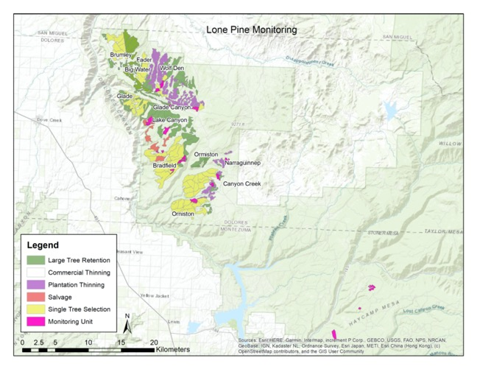
Why are you cramming so many graphs on a page, Dr. Remke?
Each monitoring unit is pretty distant from another
Forest data is often auto-correlated – everything is related to everything else
  Near things are more related than distant things
  Which means in variable landscapes relating distant units to each other is limited to impossible

Slide 43
Why are you cramming so many graphs on a page, Dr. Remke?
Each monitoring unit is pretty distant from another
Forest data is often auto-correlated – everything is related to everything else
  Near things are more related than distant things
  Which means in variable landscapes relating distant units to each other is limited to impossible
High Mortality Control
Control With BEST
Ferris- No treatment but treated 22 yeas ago
Haycamp… less beetle
Lake Canyon Salvage Control
Notes:
These are the control units where no treatment will be done on Lone Pine. They each represent some unique reality. BEST has the most representative control

Slide 44
Why are you cramming so many graphs on a page, Dr. Remke?
Each monitoring unit is pretty distant from another
Forest data is often auto-correlated – everything is related to everything else
  Near things are more related to distant things
  Which means in variable landscapes relating distant units to each other is limited to impossible
High Mortality Control
Control With BEST
Ferris- No treatment but treated 22 yeas ago
Haycamp… less beetle
Lake Canyon Salvage Control
Notes:
Each of these controls is highly variable in terms of stand structure

Slide 45
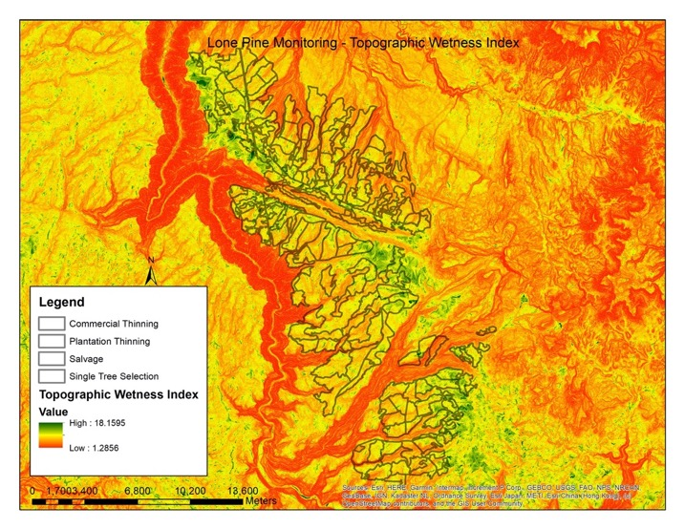
And there are a lot of gradients
Environmental gradients may represent some drivers of patterns
Making it hard to make inference beyond a ‘monitoring unit’
Multiple interacting gradients
  Soil depth, TWI, CWD?
Notes:
Environmental gradients drive patterns in stand conditions in diverse ways. There are numerous interacting gradients on the Lone Pine Landscape.

Slide 46
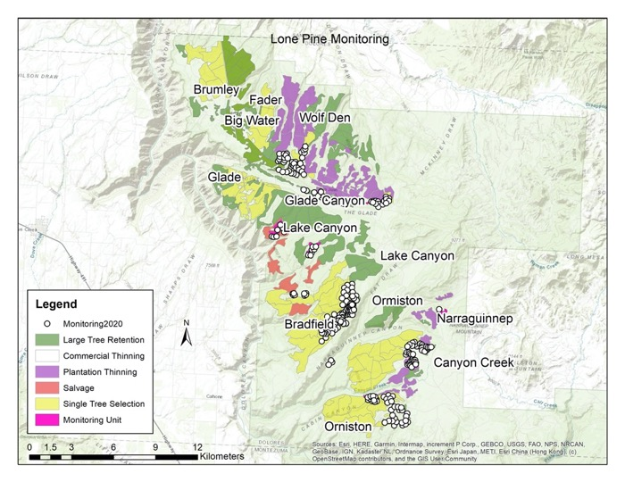
Results: Ormiston Block
MSI Added units to monitoring to learn more than just what existed within a Monitoring Unit
For example,
  Ormiston contains Ferris which is the PPP monitoring unit and a STS treatment and a CT Treatment. How do they vary in terms of DWRF Desired Conditions

Slide 47
Methods
At this point, a comparison of means and standard deviation is appropriate, however, no statistical analysis has been performed.
  Highly variable landscape – the point is to capture pre-and post effects, not really compare treatments.

Slide 48
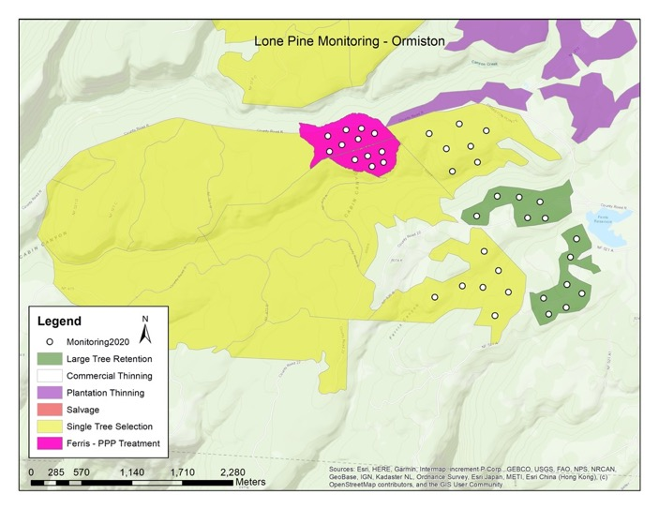
Ormiston
Contains 9 Commercial Thinning Unit (LTR), and 12 Single Tree Selection Units
And two units that were treated in 1998 with a 20” Diameter Cap as part of the Ponderosa Pines Partnership, known as Ferris

Slide 49
Ormiston
Monitored in
  Ferris units –
    No treatment under Lone Pine EA – but were treated in 1998 as part of PPP
      Large tree retention and target BA of 50-55
  STS Units
    Treatment area within Lone Pine
  CT Units
    Treatment area within Lone Pine

Slide 50
Ferris – Tree Densities
These graphs can be interpreted as
~ Y-axis variable of interest
Tree density
~X-axis tree diameter @ 4.5 feet in height
(DBH)
- 2 inch size classes.

Slide 51
Trees – All species
Ferris units lack tree like oak
  Some medium sized juniper
STS units have some small aspen trees

Slide 52
Trees - Ponderosa Pine Density
Overall Density: 61.5
0.6 % Mortality
Overall Density: 78.7
11.8 % Mortality
Overall Density: 97.3
12.1 % Mortality
Variable tree densities and mortality rates
Ferris has more large trees
Few large trees in the LTR units
Mortality occurring across most size classes in STS units
Numerous small trees
Ferris has characteristics of uneven-aged stands
  So does CT and STS units

Slide 53
Trees - Ponderosa Pine Basal Area
Most of the BA is in medium sized trees (14-20”)
Ferris has plenty of BA in mid and Large trees
Overall BA: 64.5
Live BA: 61.2
Overall BA: 87.9
Live BA: 69.3
Overall BA: 94.0
Live BA: 85.5

Slide 54
Trees - Ponderosa Pine Basal Area
Most of the BA is in medium sized trees (14-20”)
Ferris has plenty of BA in mid and Large trees
  Some tree mortality lowered BA to ~ 70
  What was BA post treating Ferris?
    Today – BA is well stocked, opportunity to remove more saw logs
Overall BA: 87.9
Live BA: 69.3

Slide 55
Trees - Ponderosa Pine Basal Area
What were conditions in Ferris immediately after treatment?
How did treatment influence tree growth and recruitment into larger size classes?
  Did they meet their BA target of 50-55?
    If so, how did that shape conditions today?
    If not, how did that shape conditions today?
Size class diversity, lower mortality from beetles, what about other desired conditions?
Overall BA: 87.9
Live BA: 69.3

Slide 56
Trees - Ponderosa Pine Regeneration
Tons of ponderosa pine regeneration in Ferris – highly variable
Regeneration in pockets and absent from other areas
NOTE: All seedlings observed were 0.25-05m in height
  Regeneration is likely only a few-several years old

Slide 57
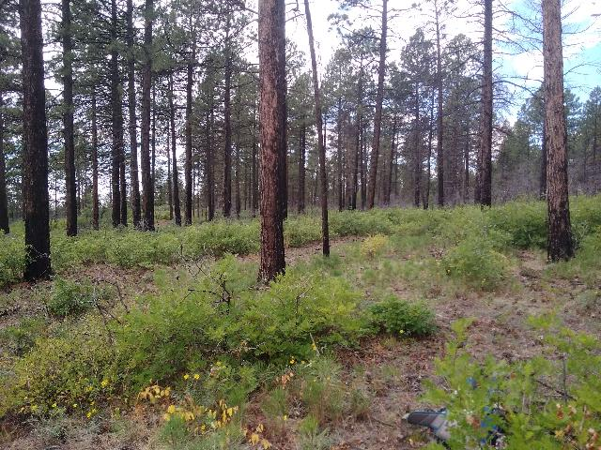
Trees - Ponderosa Pine Regeneration
Tons of ponderosa pine regeneration in Ferris – highly variable
Regeneration in pockets and absent from other areas
Plot photo from Ferris plots

Slide 58
Trees - Ponderosa Pine Regeneration
CT
Tons of ponderosa pine regeneration in Ferris – highly variable
Regeneration in pockets and absent from other areas

Slide 59
Trees - Ponderosa Pine Canopy Cover
Highly variable
  Mix of openings and closure
Most trees contributing to canopy cover are overstory codominant trees

Slide 60
Trees - Ponderosa Pine Crown Base Height
Variable CBH – likely driven by variable tree heights
CT

Slide 61
Shrubs – All species
Diverse shrub species composition
  Dominated by Gambel Oak, Serviceberry, and Snowberry
CT

Slide 62
Shrubs – Oak
More taller oaks in the LTR and STS units
More shorter oaks in Ferris
  But highly variable

Slide 63
Ground Cover – Forbs and Grasses
Minimal grass cover (~ 5-7%) in all stands
6.43
3.75
5.6
2.1
2.5
1.3

Slide 64
Ground Cover – Substrate
Forest floor is predominately litter cover with some bare soil.

Slide 65
Ground Cover – Fuels
Fuel loads are low across all fuel classes

Slide 66
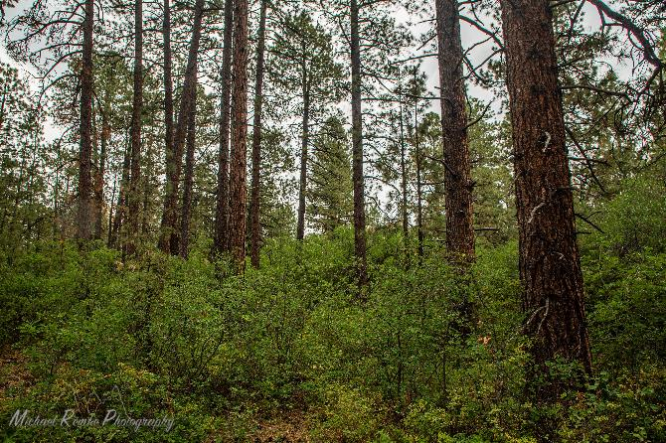
Clumpy Groupy?
We need to improve our field methods for quantifying groups.

Slide 67
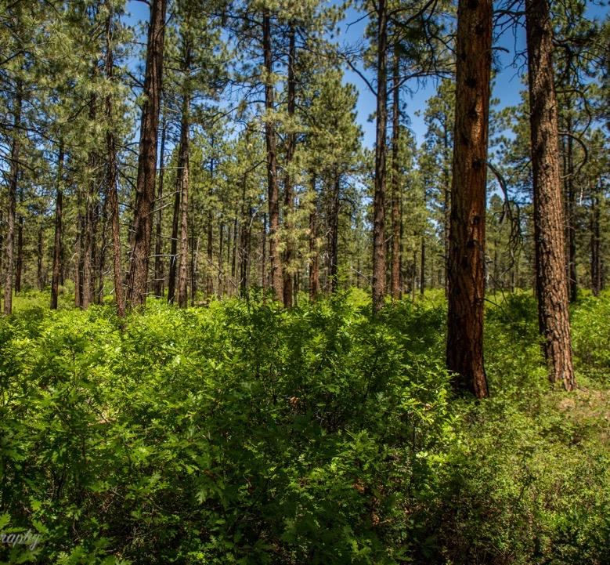
Ormiston Summary
Ormiston shows highly variable stand conditions
  Stocking densities are high in the STS selection units and Ferris units
  Tree mortality is up to 12% of standing tree density in higher density stands, but less than 1% in lower density stands
Regeneration in Ferris is notably high with over 500 seedlings per acre
  Highly variable

Slide 68
Ormiston
We have high plot densities in individual units.
  Confident that these numbers represent these units
  BUT I am not able to make inference to patterns in Ormiston– only these units
  or STS and CT units as whole

Slide 69
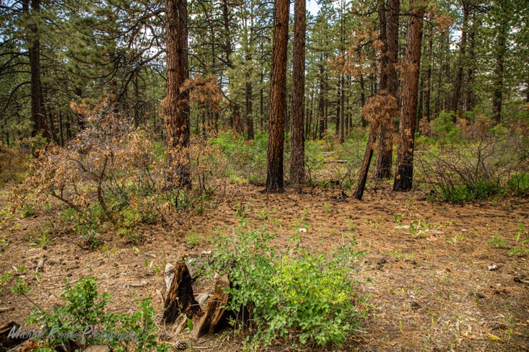
Phew – That was a lot…
Let’s bring it all together to some key points….
We have similar narratives for BEST where a control can be compared to a LTR with two BA targets (70, 90) and a STS unit (50 BA target)

Slide 70
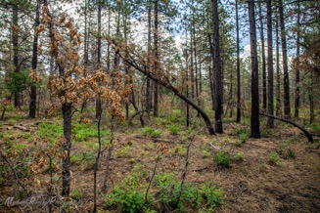
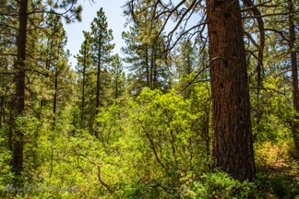
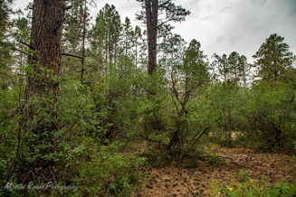
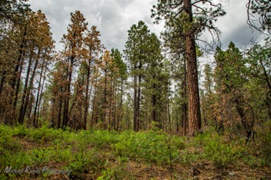
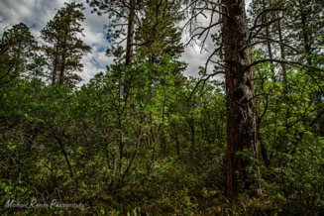
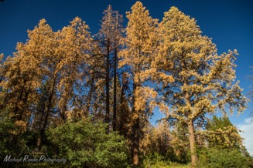
Lone Pine Overall
Lone Pine is a highly variable landscape
Large trees, small trees, live trees, dead trees, regeneration, shrubs, openings, dense canopy
  There is a lot happening across this landscape.

Slide 71
Lone Pine Monitoring Units
These established units each share their own unique narrative and have their own baselines
  However, they are not a useful means to understand at Lone Pine at large due to the highly variable landscape

Slide 72
Lone Pine Monitoring Units
  Comparing one control to a unit distant from that control in space or conditions is not useful
    Unit-unit comparisons are also difficult due to high variability and
    But we can definitely detect pre-post change in units we have plots.

Slide 73
Lone Pine Monitoring Units
  Many of the patterns articulated in DWRF desired conditions, like fire and beetles, operate on a scale larger than a unit.

Slide 74

Drought, Beetles, and Fire
Overall, regeneration is variable on the Lone Pine Landscape
  Observed regeneration in this presentation was all less than 0.5m tall
    young
    Specifically, episodic wet years or wet micro-sites are more prone to regeneration success (Brown and Wu 2005, Rodman et al. 2020a,b).
      But consistent regeneration may also be occurring….
Where is the regeneration?

Slide 75

Drought, Beetles, and Fire
Beetle mortality rates vary
  Higher density stands tend to have higher mortality rates (Nergron et al. 2008).
    Mortality is also higher on south facing slopes – perhaps exacerbating drought stress (Kolb et al 2016)
  Mortality rates are in line with other instances of roundheaded beetle activity and are close to estimates from CSFS overflight data (Nergrón et al. 2008)
Endemic mortality rates in the 1-3% range likely reflect background mortality that is normal (Sarmann et al. 2000).
What level of beetle activity are we comfortable with?

Slide 76

Drought, Beetles, and Fire
Fire risk is highest in stands with high densities
  Removal of small diameter trees can mitigate risk in heavily stoked stands.
Crown base height is generally high – disconnected vertical fuels.
What level of fire activity are we comfortable with in this landscape?

Slide 77
What about the rest of Lone Pine?
Patterns described in this talk are a small sub-section of a small amount of a large area
Interpolating across space is not advisable
  remote sensing could fill in some knowledge gaps
Summaries at the unit level are robust ( ~ 1plot/10acres).

Slide 78

STS vs. LTR comparison Plots -
Getting plots in Brumley and the northern units of Fader would be useful comparisons to ask
  How does the 20” diameter cap influence The Single Tree Selection Treatments?

Slide 79
Unit based Monitoring has limitations
To effectively address monitoring of a large EA
The monitoring units and data presented here give us detailed information in regard to specific portions of Lone Pine –
  The majority of blocks and treatment area are un-monitored.
  Variation in the landscape could reveal different patterns not detected with this sampling design

Slide 80
Unit based monitoring to capture environmental gradients
Environmental gradients may represent some drivers of patterns
Ensuring extremes and the median of a gradient are sampled can help explain variation without sampling the entire project area
Multiple interacting gradients
  Soil depth, TWI, CWD?

Slide 81

EA Monitoring
  Plots can be placed across the treatment area to detect change – cover the entire geography rather than a subset of units
  Gray and Zachman completed a power analysis and discovered 1 plot for every 50 acres can detect change in Northern Arizona Ponderosa Pine systems (4FRI)
    722 plots for effective EA based monitoring at Lone Pine
      + Representative controls!
Targeting Blocks instead of Units?
Increasing plot speed by simplifying?
Monitoring designs are complicated…
Remote sensing based monitoring?

Slide 82

Monitoring Questions
Pointed questions about monitoring can help us narrow down how to effectively monitor, and importantly what is missing from these perspectives?

Slide 83

Monitoring Questions
Pointed questions about monitoring can help us narrow down how to effectively monitor
Wood products and social dimensions
  Including recreation values

Slide 84

Integrating the Human Components into Ponderosa Pine Ecology
We have industry support – almost no one in the SW can make this claim
  How can we mitigate risk of fire, beetle, and drought mortality while also sustaining the needs of industry AND how can we target our monitoring to ensure integrated perspectives and outcomes?
    Social
    Economic
    Ecological

Slide 85

Questions…. Thoughts

Slide 86

BEST
Beetle Eradication Sanitation Thinning
  Productive site with a 20” diameter cap
  Emphasis on reduction of intensity of beetle mortality
  Represents more productive sites at Lone Pine
  Contains two Control Units and four treatment units
    Two 70 basal area target units and two 90 basal area target units

Slide 87

BEST
In more productive units, what are beetle related mortality rates?
Does the LTR diameter cap make it difficult to effectively reduce stand density and basal area?
Is regeneration present in untreated, productive stands?

Slide 88
Trees - Ponderosa Pine Density
Overall Density: 121
20 % Mortality
Overall Density: 128
7.5 % Mortality
Overall Density: 110
5.7 % Mortality
Few trees <6”
Many trees in the 6-10” size class
Beetle mortality across all size classes
Large trees are un-common in the control
  More common in the LTR units

Slide 89
Trees - Ponderosa Pine Basal Area
Overall BA: 96
Live BA: 68
Overall BA: 126
Live BA: 114
Overall BA: 117
Live BA: 111
Most of the BA is in the 16-20” size classes
  LTR units have lots of BA in the 20-24” size classes too
  LTR and STS are fairly similar

Slide 90
Trees - Ponderosa Pine Regeneration
Highly variable regeneration
Some areas have none!
Some areas have dense regeneration pockets
In many cases observers noted that regeneration was observed in oak shrubs

Slide 91
Trees - Ponderosa Pine Regeneration
Highly variable regeneration
Some areas have none!
Some areas have dense regeneration pockets
In many cases observers noted that regeneration was observed in oak shrubs

Slide 92

BEST Summary
The majority of basal area is in the 14-20” size classes
  Tress greater than 20” are impacted by bark beetles – standing dead trees
Regeneration is variable but present within these stands
  Many observations documented regeneration in clumps of oak

Slide 93

Glade Canyon
South facing slopes with higher than average beetle mortality across Lone Pine units
  Contains a control with severe mortality and a commercial thin unit (LTR)

Slide 94

Glade Canyon
Are rates of severe beetle mortality comparable to tree related mortality events in other locations?
  Up to 66% in Arizona, Utah, and New Mexico
    All size classes impacted
    (Nergrón et al. 2008a,b, Nergrón et al. 2009)
On this dry site, is regeneration still present?
How does high tree mortality influence forest fuels?

Slide 95
Trees - Ponderosa Pine Density
Overall Density: 75
65.0 % Mortality
Overall Density: 93.3
32.1 % Mortality
Tree density in the control was lower than density in the LTR units
  Perhaps because of some fallen dead trees

Slide 96

Trees - Ponderosa Pine Density
Tree density in the control was lower than density in the LTR units
  Perhaps because of some fallen dead trees
  But also, many openings
Plot Photo from Glade Canyon Control Unit
Overall Density: 75
65.0 % Mortality
Overall Density: 93.3
32.1 % Mortality

Slide 97
Trees - Ponderosa Pine Basal Area
More basal area in large trees
Mortality across all size classes
  More old mortality in the control
  As well as some recent mortality
Overall BA: 103
Live BA: 22.5
Overall BA: 113
Live BA: 86.2

Slide 98
Trees - Ponderosa Pine Regeneration
Few seedlings observed in these units
Unfavorable environment?
  South facing slopes are fairly dry?
  Stand conditions?

Slide 99
Ground Cover – Fuels
Fuels are similar in these two units
Not excessively high but higher than in the units we looked at in Ormiston

Slide 100

Glade Canyon
Shows high tree mortality
  Similar mortality rates to other outbreaks of roundheaded beetle (Negrón et al. 2008)
    All size classes impacted
    A mix of more recent and older mortality
Minimal tree regeneration
Fuels remain fairly low – could change as mortality ages
These areas have high density AND are on a south facing slope

Slide 101
BEST – Extra graphs

Slide 102
Trees – All species

Slide 103
Trees - Ponderosa Pine Canopy Cover

Slide 104
Trees - Ponderosa Pine Crown Base Height

Slide 105
Shrubs – All species

Slide 106
Shrubs – Oak

Slide 107
Ground Cover – Forbs and Grasses

Slide 108
Ground Cover – Substrate

Slide 109
Ground Cover – Fuels

Slide 110
Glade Canyon – Extra Graphs

Slide 111
Trees – All species

Slide 112
Trees - Ponderosa Pine Canopy Cover

Slide 113
Trees - Ponderosa Pine Crown Base Height

Slide 114
Shrubs – All species

Slide 115
Shrubs – Oak

Slide 116
Ground Cover – Forbs and Grasses

Slide 117
Ground Cover – Substrate

